Slide 1
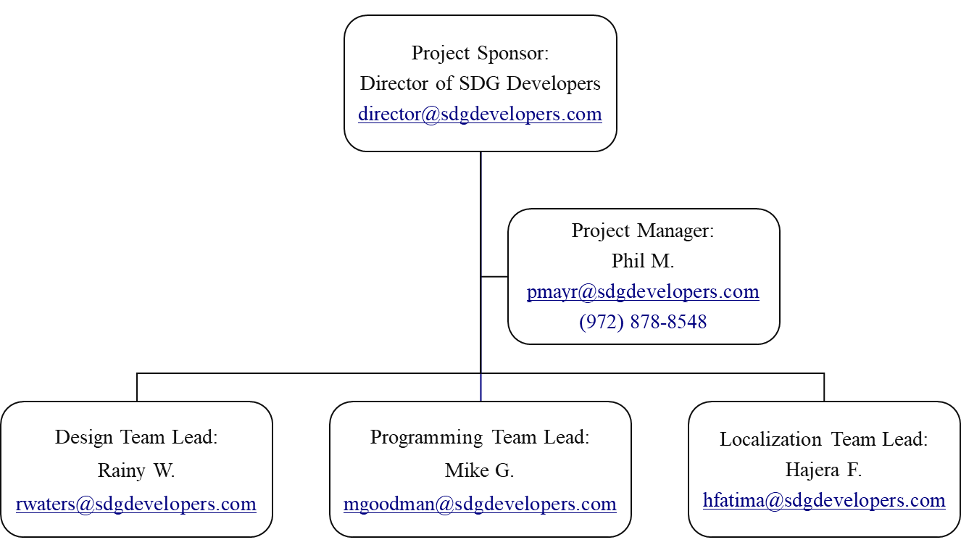
Tuner & Metronome Project Organizational Chart
3/17/25

